Slide 1


SA104

Slide 2
ORDER OF PRESENTATION
FELIX - INTRODUCTION
TRANG - DEFEAT RISKS
VAN - DEFEAT IGNORANCE
TIFFANY - DEFEAT MISINFORMATION

Slide 3
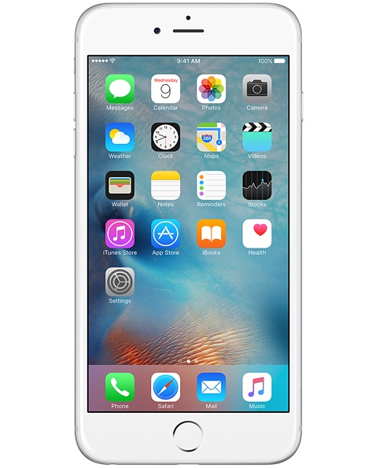
FELIX
Introduction
INTRODUCTION OF PROBLEM
$600
$100
$600
$1200
$600
$2000

Slide 4
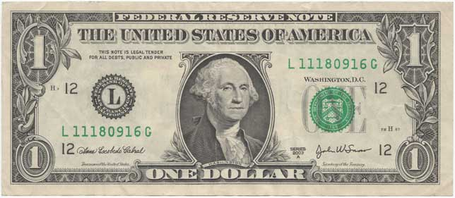
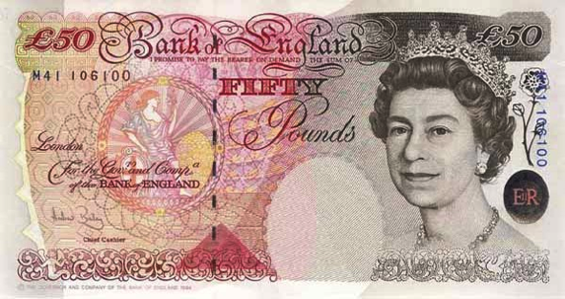
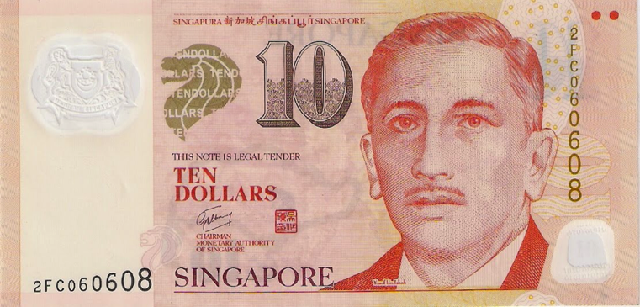
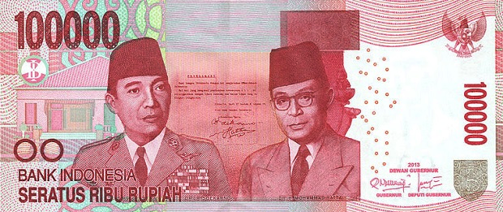
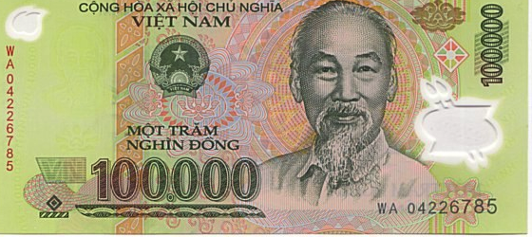
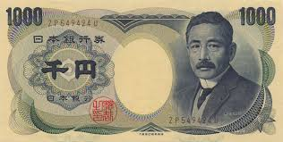
FELIX
Introduction
INTRODUCTION OF PROBLEM

Slide 5
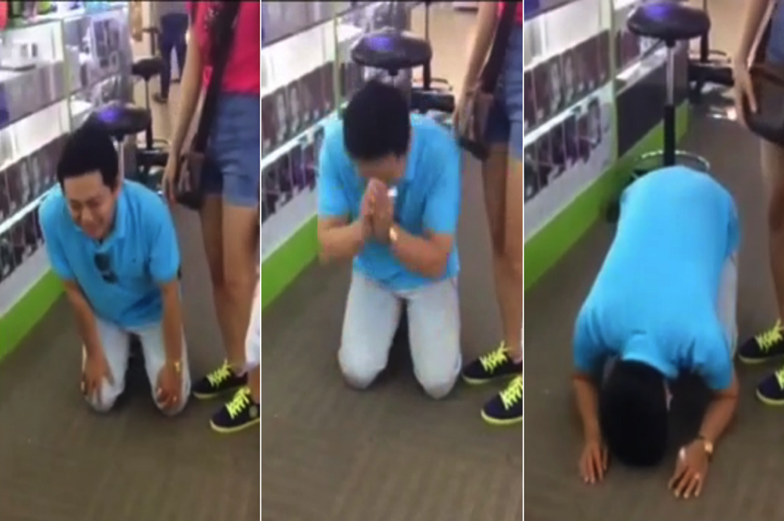
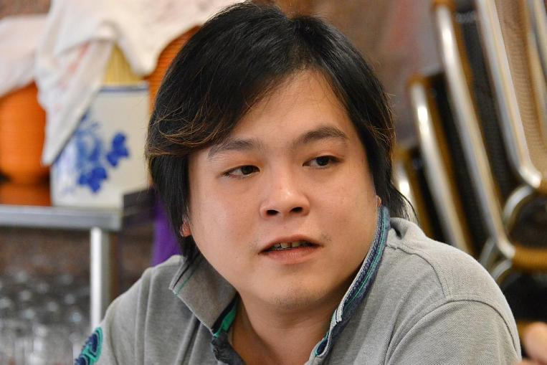
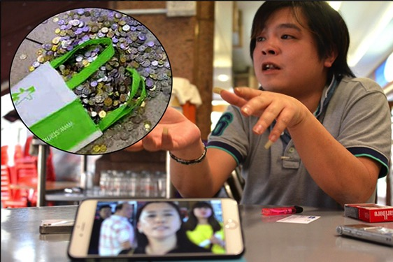
FELIX
Introduction
INTRODUCTION OF PROBLEM

Slide 6



FELIX
Introduction
INTRODUCTION OF PROBLEM

Slide 7
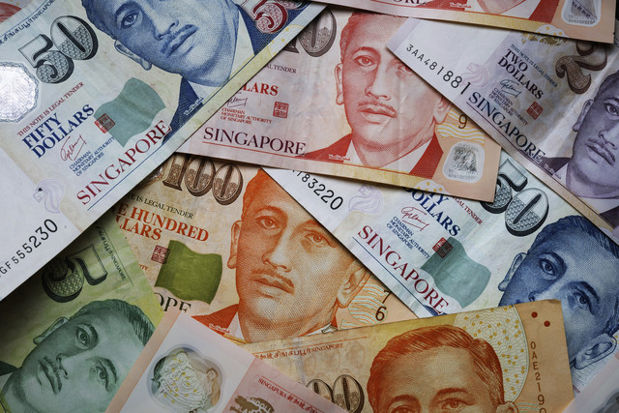
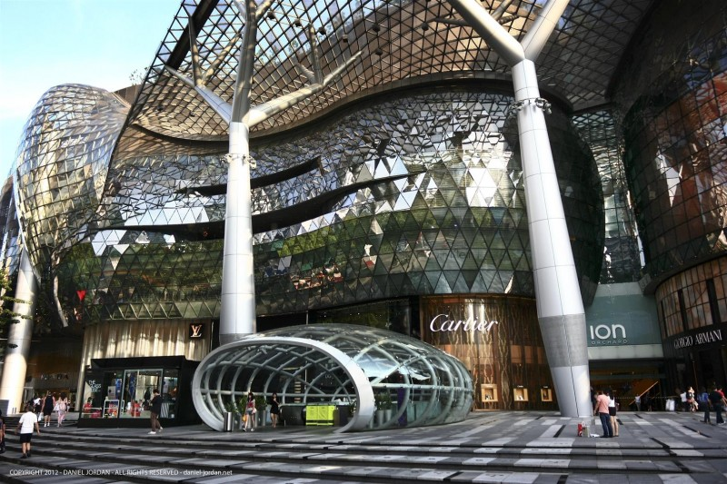
FELIX
Introduction
IMPACT OF RETAIL SCAMMING

Slide 8

FELIX
Introduction
WHY TOURISTS VISIT SINGAPORE?
Price
38
Safety
39
47
Comfort
Variety
17

Slide 9
FELIX
Introduction
NUMBER OF SCAM CASES REPORTED

Slide 10
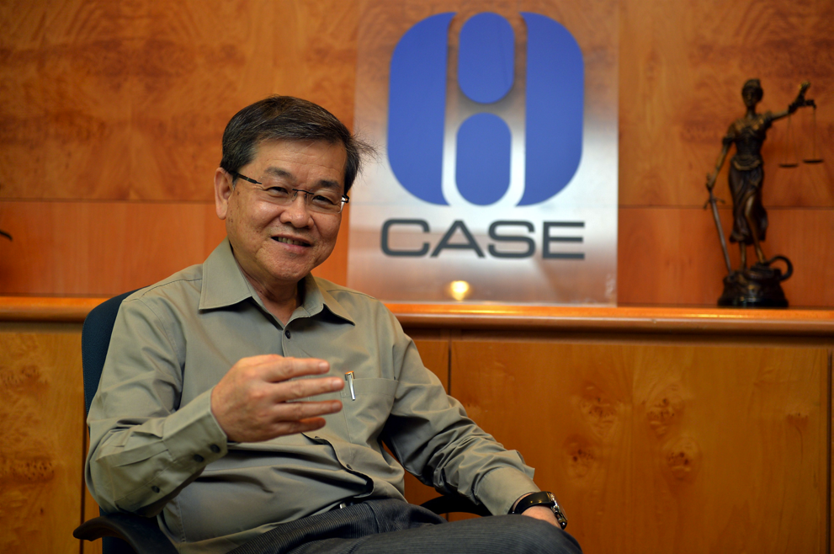
FELIX
Introduction
OUR INTERVIEWEE
Mr. Seah Seng Choon
Executive Director of CASE

Slide 11

FELIX
Introduction
TOURIST ARRIVALS
SINGAPORE

Slide 12



FELIX
Introduction
STAKEHOLDERS

Slide 13
FELIX
Introduction
APPROACH DIAGRAM
DEFEAT THE CHEATS
DEFEAT
RISKS
DEFEAT
IGNORANCE
DEFEAT
MISINFORMATION
EXCELLENT
RETAILER
AWARD
CLEVER CUSTOMER
MULTILINGUAL GUIDE

Slide 14
TRANG
Defeat Risks
E.R.A.
Notes:
Remove background for question picture

Slide 15


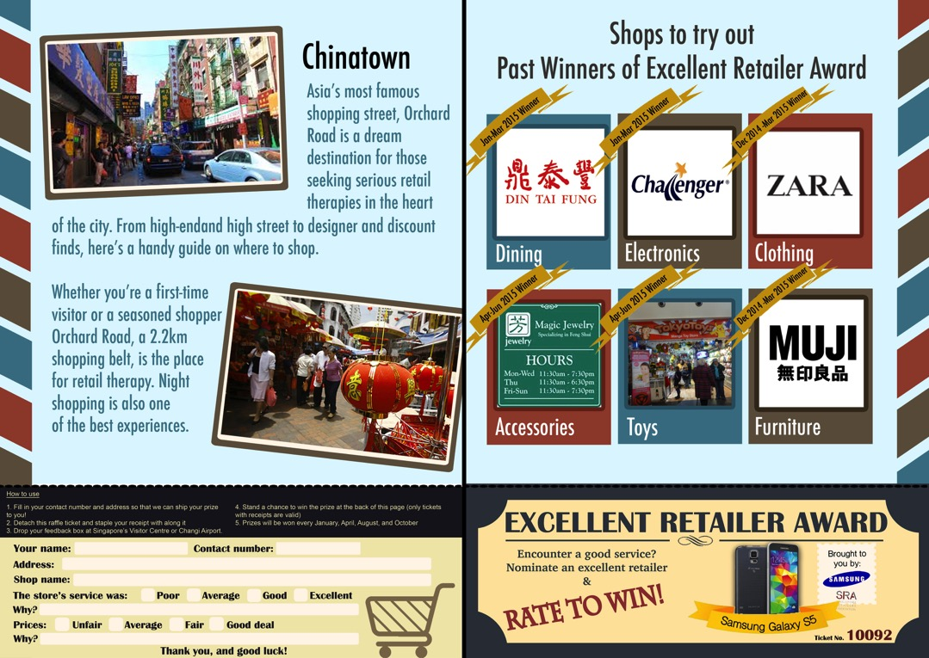
TRANG
Defeat Risks
BOOKLET

Slide 16
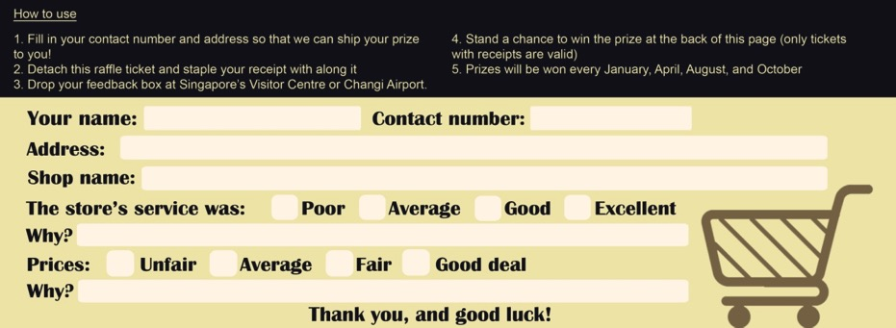

TRANG
Defeat Risks
TICKET

Slide 17

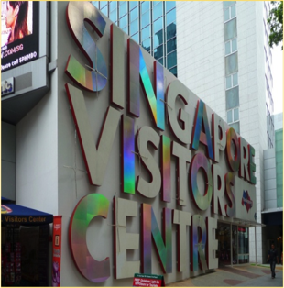
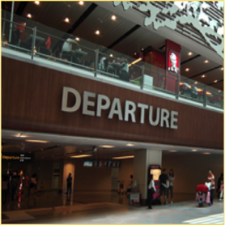

TRANG
Defeat Risks
FEEDBACK FORM
Notes:
Remove background for question picture

Slide 18

TRANG
Defeat Risks
E.R.A. CERTIFICATE

Slide 19


TRANG
Defeat Rsks
ANALYSIS OF KEY FINDINGS
77%
77%

Slide 20


TRANG
Defeat Risks
STRENGTH OF ERA
Notes:
Remove background for question picture

Slide 21




TRANG
Defeat Risks
LIMITATION OF ERA

Slide 22

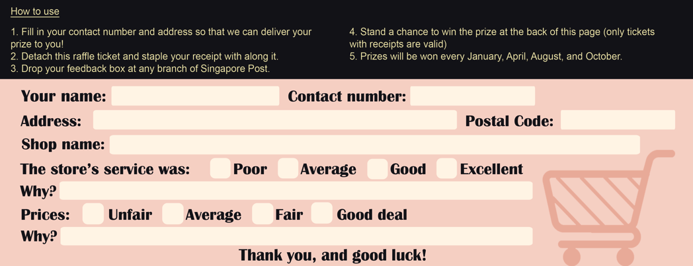
TRANG
Defeat Risks
SOLUTION
1

Slide 23

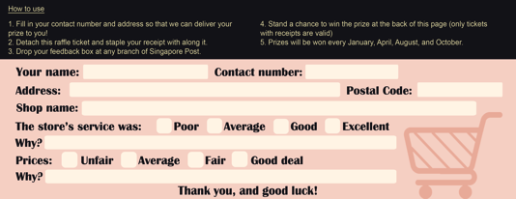
TRANG
Defeat Risks
SOLUTION

Slide 24
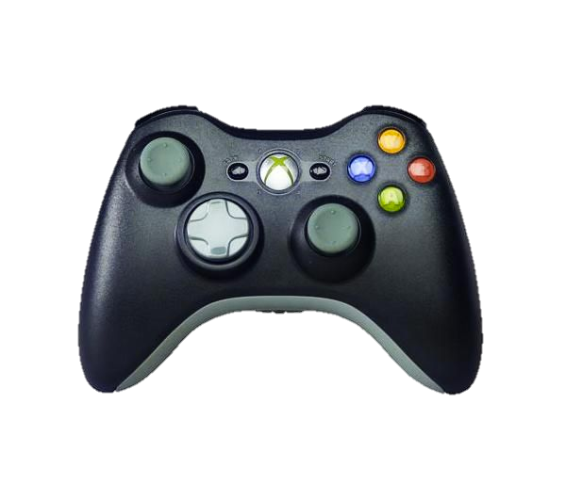

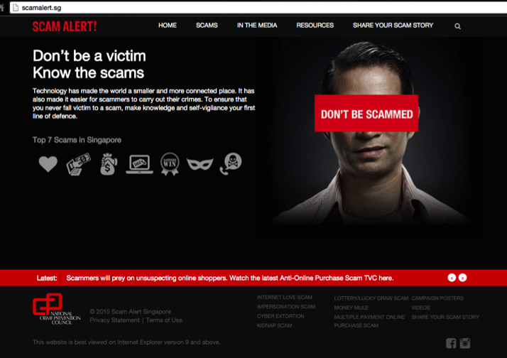
VAN
Defeat Ignorance
CLEVER CUSTOMER

Slide 25



VAN
Defeat Ignorance
CLEVER CUSTOMER
CLEVER
CUSTOMER
CLEVER
CUSTOMER
CLEVER
CUSTOMER

Slide 26
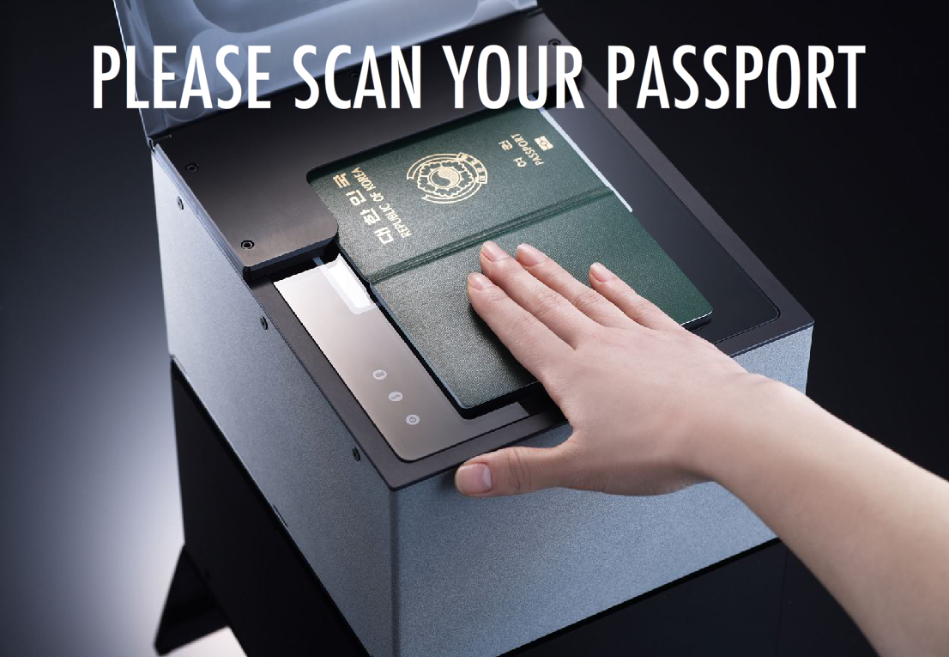

VAN
Defeat Ignorance
STEP 1: SCAN YOUR PASSPORT
Play the game

Slide 27
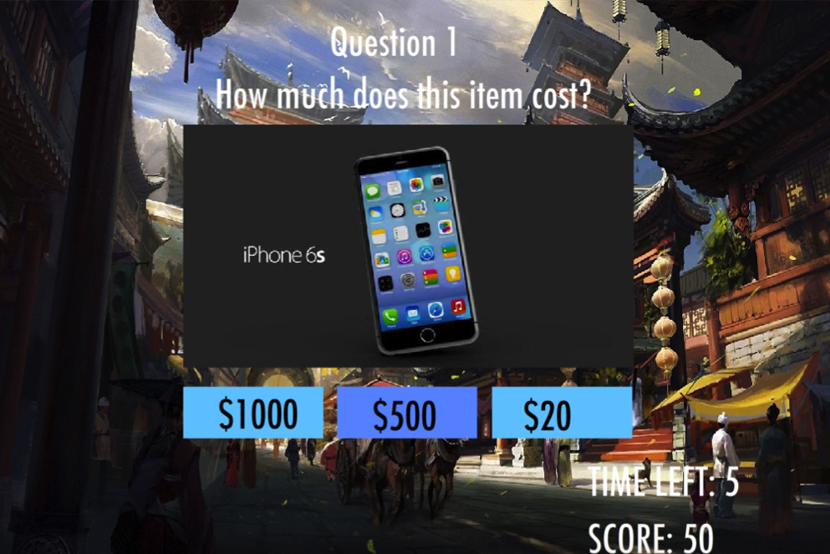
VAN
Defeat Ignorance
STEP 2: PLAY THE GAME

Slide 28
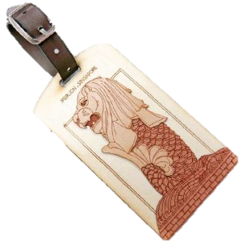
VAN
Defeat Ignorance
STEP 3: COLLECT YOUR PRIZES

Slide 29
VAN
Defeat Ignorance
ANALYSIS OF KEY FINDINGS
“GAMING IS FEASIBLE
AND EFFECTIVE”
“PREVENTION IS
BETTER THAN CURE”

Slide 30
VAN
Defeat Ignorance
STRENGTHS
VIRTUAL SHOPPING

Slide 31





VAN
Defeat Ignorance
STRENGTHS

Slide 32


VAN
Defeat Ignorance
LIMITATION
$

Slide 33

TIFFANY
Defeat Misinformation
MULTILINGUAL GUIDE

Slide 34


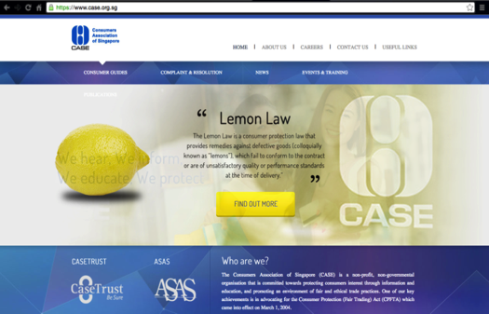
TIFFANY
Defeat Misinformation
MULTILINGUAL GUIDE
TARGETTED AT LOCALS
ENGLISH
INEFFECTIVE

Slide 35


TIFFANY
Defeat Misinformation
MULTILINGUAL GUIDE

Slide 36
TIFFANY
Defeat Misinformation
PAMPHLETS

Slide 37

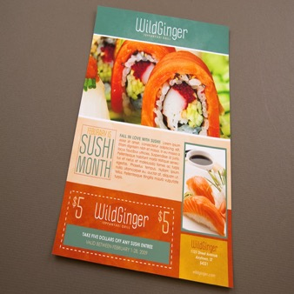
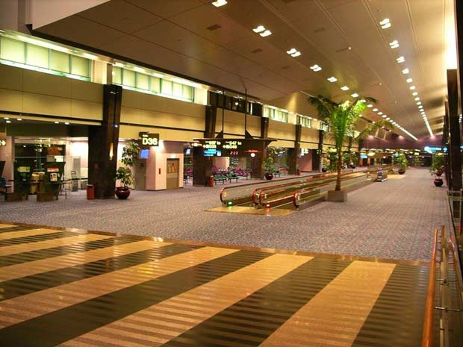
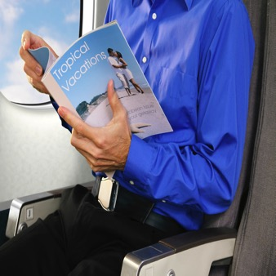
TIFFANY
Defeat Misinformation
LOCATION

Slide 38
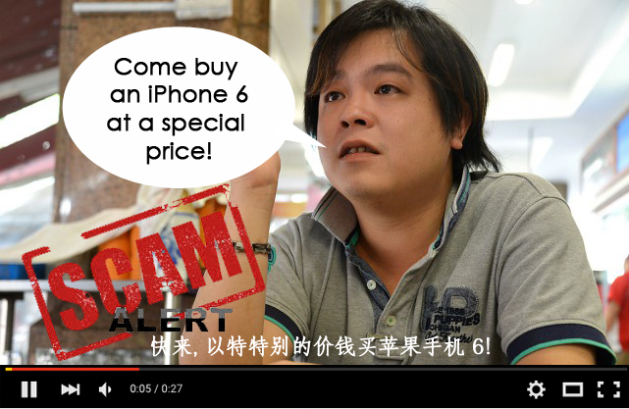
TIFFANY
Defeat Misinformation
VIDEOS

Slide 39
TIFFANY
Defeat Misinformation
LOCATION
33%

Slide 40



TIFFANY
Defeat Misinformation
ANALYSIS OF KEY FINDINGS
85%
EASY
96%

Slide 41
GROUP VIDEO

Slide 42
QUESTION AND ANSWER

